Slide 1
MINI ELECTRONICS VOTING MACHINE

Slide 2
CREATED BY
ASHWANI PANDEY
GUIDED BY
MR. MD. ASIF IQBAL

Slide 3
OUT LINE OF PRESENTATION
INTRODUCTION
CIRCUIT DIAGRAM
CIRCUIT DISCRIPTION
COMPONENT LIST
REFERANCES

Slide 4
INTRODUCTION
It is a mini Electronic voting machine. It is used in voting and counting of votes.
This Electronic voting machine use so avoiding the long process of counting manually.
It is used four candidates.

Slide 5
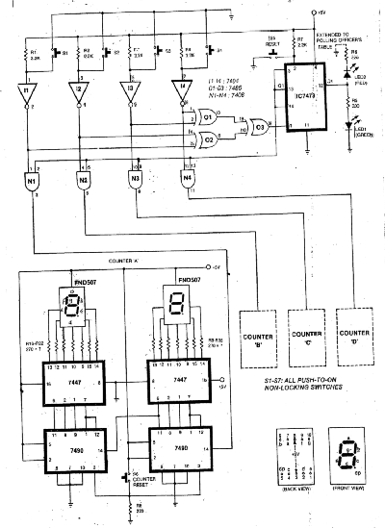
CIRCUIT DIAGRAM

Slide 6
CIRCUIT DISCRIPTION
SWITCH s1 to s4 are the four push –to-on type non locking
switches . One for each candidate.
- vote casting is done by just pressing a corresponding switch.
LED1 glows to indicate to the voter that his vote has been
cast (recording).
XORGATE (IC7486) prevents the votes can be cast two buttons
are pressed simultaneously.
IC7473 locks self once a vote has been cast and thus prevents multiple votes by a person.
It simultaneously lights LED2 at polling officer’s table.
Pin 13 of IC7473 goes ‘low’ as soon as a ‘valid’ vote recorded.
This in turn blocks all AND gate to avoid further counting of votes till the officer in charge reset the system through switch S7 at his table.
Resetting of S7 should be done only when the voter has come out of the both after casting his vote.

Slide 7
CIRCUIT DESCIPTION
The counting of votes is carried out by the counters wired using
IC 7490.
Only ‘unit’ and ‘tens’ positions are shown.
Depending on the number of voters expected the hundredth and the thousandth positions can also be wired.
The votes corresponding to S1-S4 are counted by counters C1-C4, respectively.
Switch S6 must be keep under a lock and key arrangement.
It should be reset before the voting starts and should not be disturbed there after till the voting is over and the results have been declare.
Counters will store the digits as far as supply continues without failure.
So on interrupted +5V supply derived from a battery is advisable.
This machine can be used in school , college election.

Slide 8
COMPONENT LIST
IC-7447,7490,7473,7404,7486,7408
REGISTER- R-2.2K, R-220Ω, R-270Ω
LED-GREEN LED, RED LED.
SWITCH- S1 TO S6
DISPLAY- FND507

Slide 9
IC 7404
This IC work as 2 –input inverter
It Boolean functions is Y= not A
TRUTH TABLE
INPUT (A) | OUTPUT(Y)
HIGH | LOW
LOW | HIGH

Slide 10
IC 7408
These devices contain four independent 2-input
positive-AND gates.
They perform the Boolean functions Y = A • B in positive logic.
TRUTH TABLE
INPUT(A) | INPUT(B) | OUTPUT(Y)
LOW | LOW | LOW
LOW | HIGH | LOW
HIGH | LOW | LOW
HIGH | HIGH | HIGH

Slide 11
IC 7486
This IC work as 2-input XOR gate .
Its Boolean function is Y= not A* B +not B*A
Truth table
INPUT(A) | INPUT(B) | OUTPUT(Y)
LOW | LOW | LOW
LOW | HIGH | HIGH
HIGH | LOW | HIGH
HIGH | HIGH | LOW

Slide 12
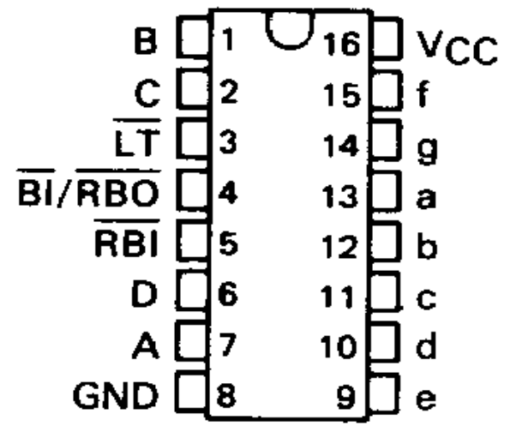
IC 7447
This IC work as BCD to SEVEN SEGMENT DECODER/DRIVERS

Slide 13
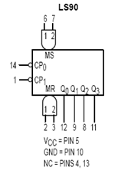
IC 7490
This IC work as a BCD decade counter.
It counts zero to nine digit.

Slide 14
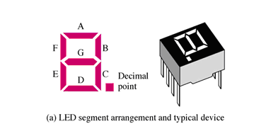
SEVEN SEGMENT DISPLAY
Seven segment display are two type.
Common anode.
Common cathode.
In display common anode is more suitable.

Slide 15
RESISTOR
The opposition to flow of electric current is known as resistor.
R=V/IΩ .
It is two type.
Fixed resistor.
Variable resistor.

Slide 16
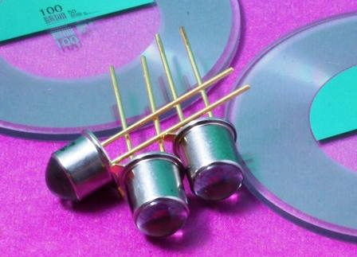
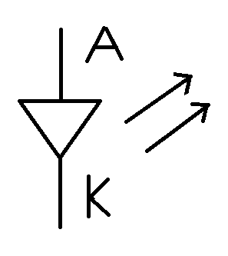
LED (light emitting diode )
In LED due to forward bias, electrons from n-type material go from the conduction band and recombine with the holes in the valence band of p-type material. So energy in the from of light is radiated.

Slide 17
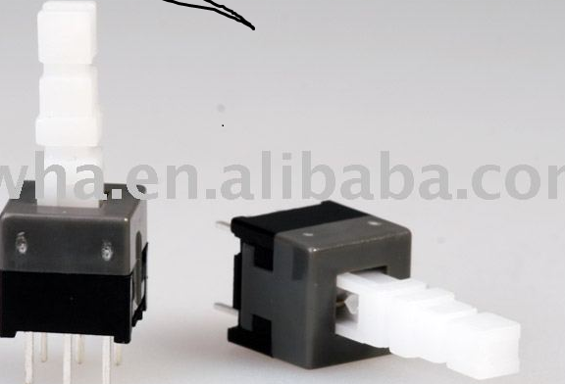
SWITCHES
This is push -to-on switches.
It push to switch on, then it automatically in off state.

Slide 18
ADVANTAGES
It count votes easily and fasttly.
It is reduce invalid votes is easily.
This is avoid the long process of votes counting.
It is easy to modify for required No of candidates.

Slide 19
DISADVANTAGES
It is used for only four condidates.
When it is used for more condidates we can change circuit and then used.

Slide 20
APPLICATION
It is used in general elections for choosing candidates to represent people at various stages.
2. It can be used in school ,college student union elections.
3. It can be used to find the general opinion of people on various issues.
4. Anywhere where majority opinion is to be found out

Slide 21
REFERANCE
WWW.PROJECT.COM
WWW.DATASHEET.COM
WWW.EFY.COM
VALUME SIX

Slide 22
THANK YOU

